Slide 1
“XamarinAPICovid19” project
Using “COVID-19 Coronavirus Statistics” API from RapidAPI
By:
Vashisht
Karandeep Singh Gainde
Jobanpreet Singh
Tajbir Singh

Slide 2
Root and Data from the API
Creating Root and Data Classes
1. Root.cs:
a. error, statusCode, message, and data at Class Data.
2. Data.cs:
b. recovered, deaths, confirmed, lastChecked, lastReported, and location.

Slide 3
CovidAPI from the API
Creating CovidAPI Class to make the connection
1. CovidAPI.cs:
a. Get the data from the URL.
b. Read the contents.
c. Convert the contents using Json.

Slide 4
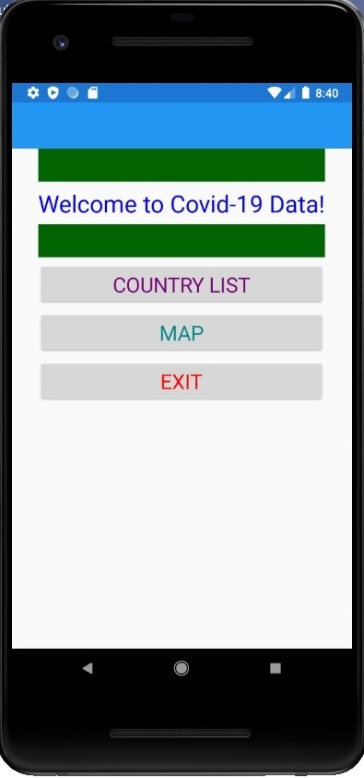
Main Page
Creating MainPage.xaml.cs
1. Message
a. Welcome to Covid-19 Data! message.
2. Buttons
a. COUNTRY LIST to navigate to CountryListPage.
b. MAP to navigate to MapPage.
c. EXIT to kill.

Slide 5
How to Create A List View of the Countries
1. I created an array of 20 countries which I used in the App:
String[] CountryArr = new string[20];
2. I gave each string of the array a value:
…CountryArr[10] = "Mexico";
CountryArr[11] = "New Zealand";
CountryArr[12] = "Norway";…
3. I created a grid to contain the data:
Grid grid = new Grid();

Slide 6
How to Create A List View of the Countries
4. I created an for loop that will run through each country of the Array:
for (int r = 0; r < (CountryArr.Length * 3); r++)
Note: Each country will have 3 rows:
1. Country Name
2. Death, Cases & Recovered Headings
3. The Stats
5. I set a variable for Country and made the first row’s label show that text:
string Country = CountryArr[CountryCount];
Text = Country
I added 1 to row after this.

Slide 7
How to Create A List View of the Countries
6. For the second row I showed the headings of the different data in columns next to each other:
Text = "'Deaths':",
Grid.SetColumn(DeathBoxLbl, 0);
Text = "'Confirmed' Cases:",
Grid.SetColumn(ConfirmLbl, 1);
Text = "'Recovered':",
Grid.SetColumn(RecoverLbl, 2);
I added 1 to row after this.

Slide 8
How to Create A List View of the Countries
7. For the third row I showed the data of Deaths, Cases & Recovered. Firstly, I made a for loop for each column:
for (int c = 0; c < 3; c++)
8. Then I made a switch to for each case of the for loop:
switch (c)
case 0:
case 1:
case 2:

Slide 9
How to Create A List View of the Countries
9. Then I created a function to retrieve the API data for a specified country and put it in a label:
public async void GetDeathNum(string Country, Label DeathLbl) {
var deathNum = await CAPI.ReturnDeaths(Country);
DeathLbl.Text = Convert.ToString(deathNum);
}
10. Then I made a switch to for each case of the for loop:
GetDeathNum(Country, ThisLabel);

Slide 10
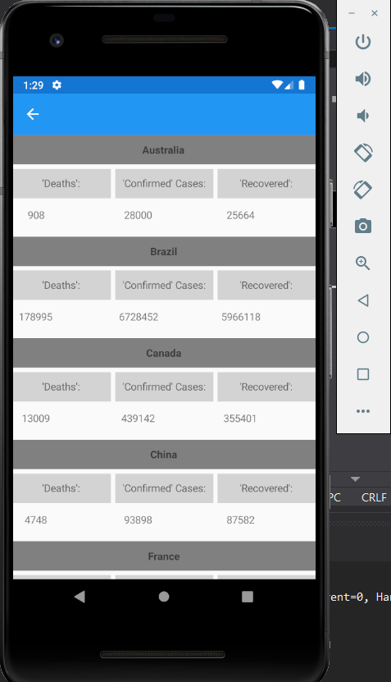
How to Create A List View of the Countries
The finished product looks like this:

Slide 11
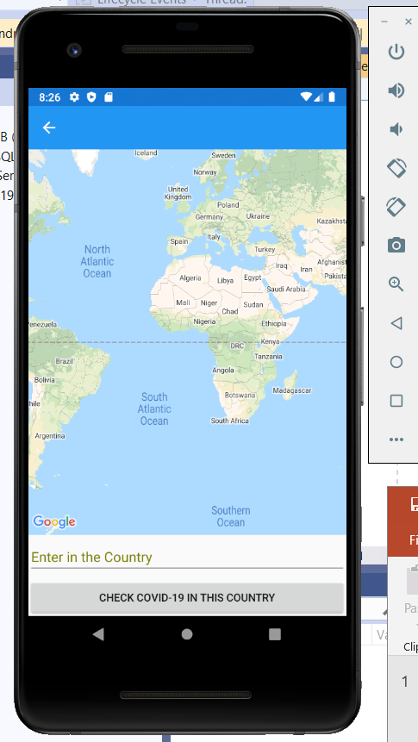
Google Maps API
Enter in a Country name in the Entry.
Click the button “Check Covid-19 in This Country”.
Google API try to find the country location.
If the country location is found move to location.
Get Covid19 data of that country using COVID-19 API “COVID-19 Coronavirus Statistics API”.
Create pin and add the data.
Place the pin on the map where the location is.

Slide 12
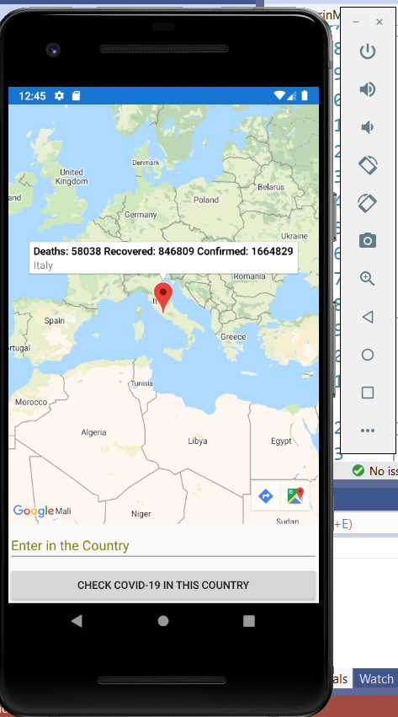
8. Click on the pin.
9. Covid19 Information is displayed.

Slide 13
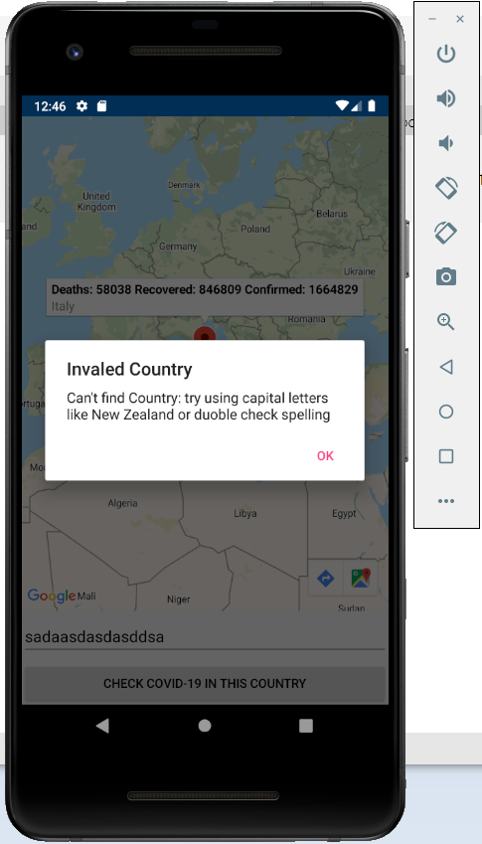
If the Country Location couldn’t be found.
Display an Error.

Slide 14
Agile

Slide 15
Agile vs Waterfall Development

Slide 16
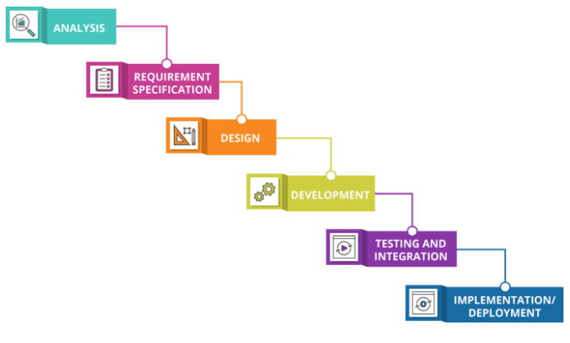

Slide 17
Waterfall Development:
Linear process
A lot of hand-offs between siloed teams
Large amounts of written documentation
Fixes scope, cost, and duration up front
Relies on detailed planning and design up front to reduce risk
Change adverse or costly to change
Relies on project manager to collect project status and report
Value delivered at the end of project

Slide 18
Problems with traditional development process
Artefact reviews can't prove the product is correct, or measure the project's true progress
Overly precise plans are difficult to change
Unnecessary dependencies cause blocked or delayed work
Business must completely specify the product upfront
Conformance to plan over change and adaptation
Long feedback loops
Impeded innovation
Unnecessary overhead and bureaucracy
Relies on project manager to collect project status and report
Value delivered at the end of project

Slide 19
Agile Development:
An iterative process - deliver regularly
Flexible duration, scope and cost
Little design documentation
Relies on frequent collaboration and short feedback loop to reduce risk
Status is visible to everyone
Deliver value quickly - within days or weeks
Change is welcome

Slide 20


Agile development vs. traditional development
Visibility Risk
Business value
Agile development
Traditional development

Slide 21
Agile Team Roles
Core Roles:
Stakeholder (often not considered to be in the agile team)
Team Lead
Product Owner
Agile Team Member
Additional Roles:
Architecture Owner
Domain Expert
Technical Expert
Independent Tester
Integrator
Specialist

Slide 22
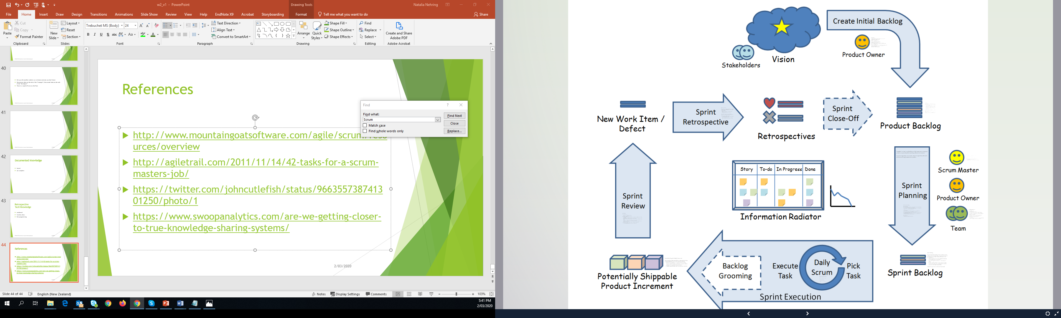
Scrum
Scrum is an agile process most commonly used for product development, especially software development.
Scrum is a project management framework that is applicable to any project with aggressive deadlines, complex requirements and a degree of uniqueness.

Slide 23
As a Scrum Master, you
Serve as the keeper of the scrum process, “holding space” for the team.
Provide facilitation for team meetings during the sprint - this can mean leading them yourself, recruiting an outside facilitator, or helping the team facilitate their own meetings.
Know when to step back and let the team learn through their own experience, including mistakes.
Are available to the team and the product owner to answer questions and give advice.
Protect the team from outside distractions, serving as a buffer between the team and external stakeholders.
Remove impediments for the team, so they can get on with the work.
Are not the boss. Your role is defined by a unique set of responsibilities, not by rank.
Help the team master the use of scrum artefacts, like the task board, the sprint backlog, and burn charts.
Coach the Product Owner and individual team members, in scrum practices.
Act as your organisation’s chief scrum evangelist, helping the entire company embrace scrum.
Lead the daily scrum until the team members are comfortable running it by themselves.
Run the second half of the story time meeting, or assist the team members in running it themselves.
Provide facilitation for, and participate in, the sprint retrospective.
Are not the scrum police!
Ensure that your duties as a technical contributor - if you are one—do not detract from your role as scrum master.

Slide 24
As a Team Member, you…
Provide Estimates
Clarify user needs (stories)
Commit to work on items from the sprint backlog
Do the work of delivering a potentially releasable Increment of “Done” product at the end of each Sprint
Share your knowledge
Report your progress in daily stand up meetings
Demonstrate your work in a Sprint Review
Contribute to Sprint Retrospective
self-organise
are accountable as a team, there is no recognised title of "tester", "analyst", everyone is a "developer"

Slide 25
As a Product Owner, you…
Hold the vision for the product on behalf of the business, the customer, and the user.
Represent the interests of the business to the team.
Represent the product and the team to the business.
Communicate with stakeholders regularly.
Do not hold the role of scrum master
Write user stories and help others write user stories.
Understand the business value of each user story.
Prioritize the user stories into a strictly ordered backlog.
Identify acceptance criteria for each story.
Collaborate with the rest of the team to create the team’s definition of done.
Accept or reject completed work, determining whether it has met the acceptance criteria.
Arbitrate conflicting requirements from stakeholders.
Do not tell the team how to do the work
Do not estimate stories – but provide the information that the team needs to estimate each story.
Make yourself available to answer the team’s questions about requirements and business value.
Make the call in the rare instances when a sprint needs to be terminated early.
Clarify requirements for the team.
Lead the first part of the sprint planning meeting.
Gather feedback from stakeholders at the sprint review.

Slide 26
Product Backlog
An ordered features list, containing short descriptions of all functionality desired in the product
Typically lists features, functions, requirements, enhancements, and fixes that are desired in the product. Technical work and knowledge acquisition also belong in the product backlog
Product Owner is responsible for Product Backlog, including its content, availability and ordering
Typically, a Scrum team and its product owner begin by writing down everything they can think of easily. This is almost always more than enough for a first sprint.
The Product Backlog evolves (allowed to grow and change) as more is learned about the product and its customers.
Multiple Scrum teams often work on the same Product Backlog; an attribute is used to group items

Slide 27
A sprint
A sprint is a time-boxed milestone that teams use to measure project progress, based on working software increments.
A sprint is typically 2 to 4 weeks. But it is agreed by the team and shorter/longer sprints are possible.

Slide 28
The Daily Scrum
The Daily Scrum is a coordination meeting that is used foster communication and collaboration and helps ensure that the entire development team is on the same page.
To achieve this, each team member must report about their work in enough detail to make it transparent to others.
Typically 15 minutes at the same time every work day

Slide 29
The goals of the meeting are to:
Focus the team on the right work
Create a sense of team accountability
Communicate what is going on
Identify issues, risks and dependencies
Support continuous improvement by exposing problems

Slide 30
Retrospective
Tell me (at least) one idea you learnt today
How can you apply what you learnt outside of the class?
Is there anything you are not clear on today's topic?
Is there anything we did that you would like changed?

